Slide 1

Chapter 16 Respiratory Physiology
VPHY 3100E
Paul Eubig
paul.eubig@uga.edu

Slide 2
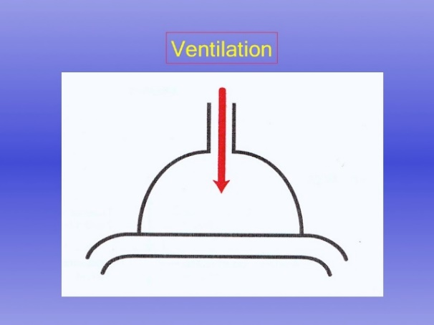
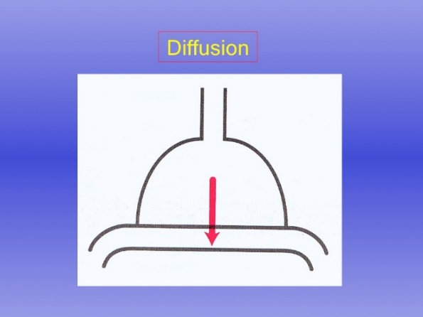
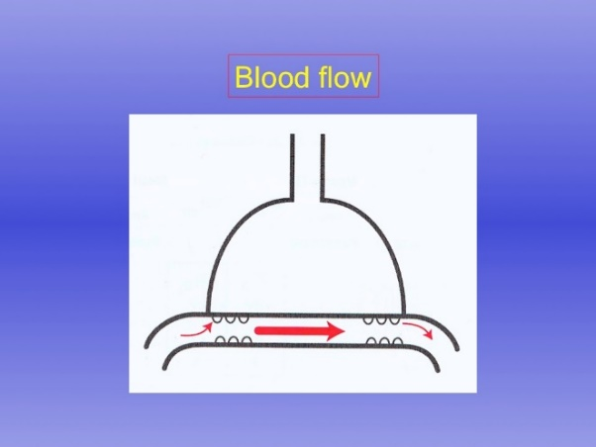
Lecture Outline
1. Introduction to respiratory system
2. Physical aspects and mechanics of ventilation
3. Factors affecting ventilation
4. O₂ & CO₂ transport
5. Acid-base balance
6. Regulation of breathing

Slide 3
Chapter 16 Respiratory Physiology
Part 1 – Introduction to the respiratory system

Slide 4
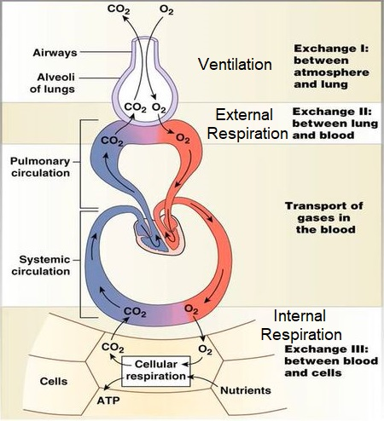
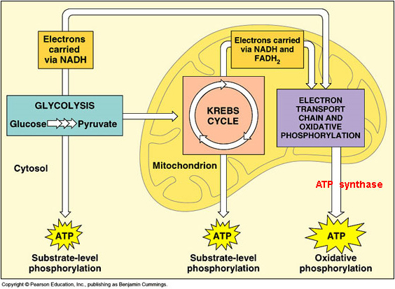
Functions of the Respiratory System
What is the purpose of this entire process?
Ventilation (breathing)
To move air into and out of respiratory system.
Gas exchange
External respiration – gas exchange between air and capillaries in the lungs
Internal respiration – gas exchange between systemic capillaries and tissues of the body
Pressure gradients generate diffusion
O₂ utilization and CO₂ production
Cellular respiration

Slide 5
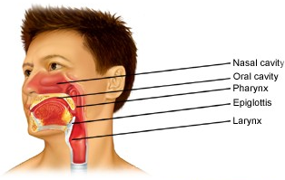
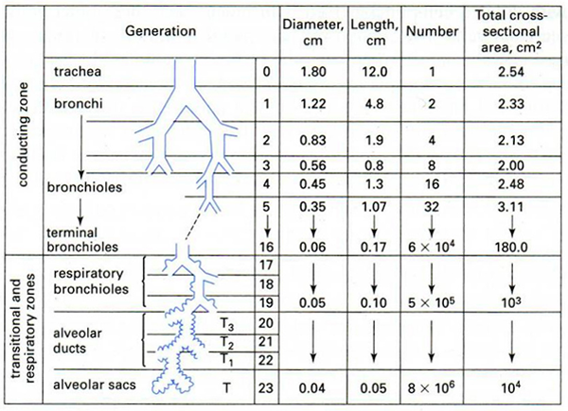
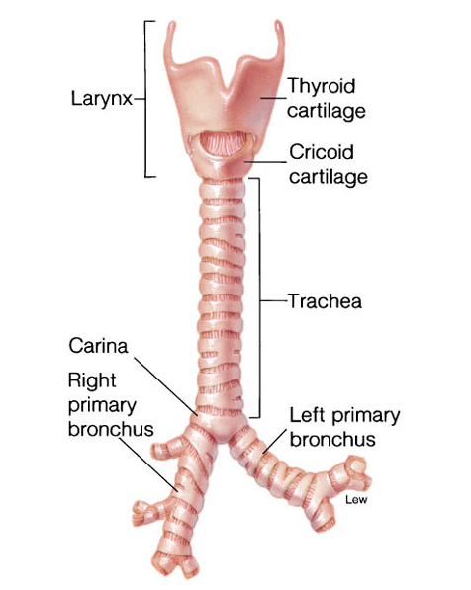
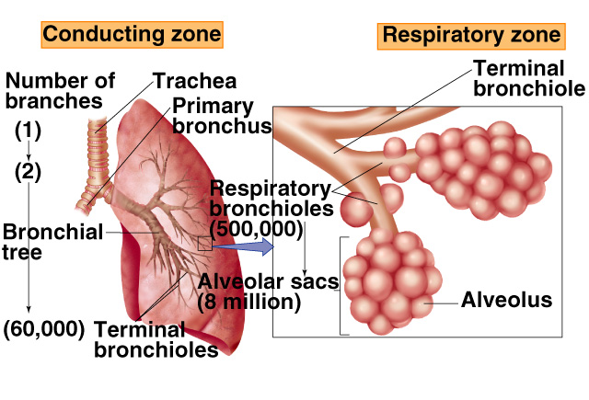
Pulmonary Structures
What happens to individual airway diameter and length as go deeper into the lungs?
Collective x-sectional area?
Airway passages
Conducting zone and respiratory zone
Conducting zone
Outside the lungs – nasal passages → pharynx → epiglottis → larynx (glottis)
Inside the lungs – trachea (1) → bronchus (2 branches) → bronchiole → … → terminal bronchiole
Respiratory zone
Respiratory bronchiole → … → alveolar sacs

Slide 6
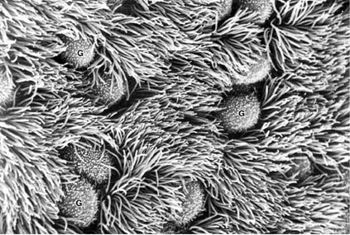
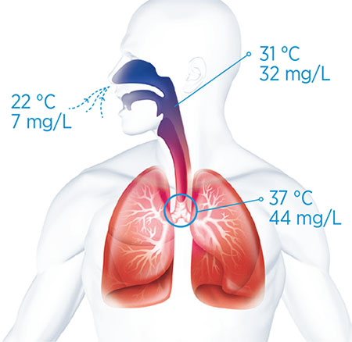
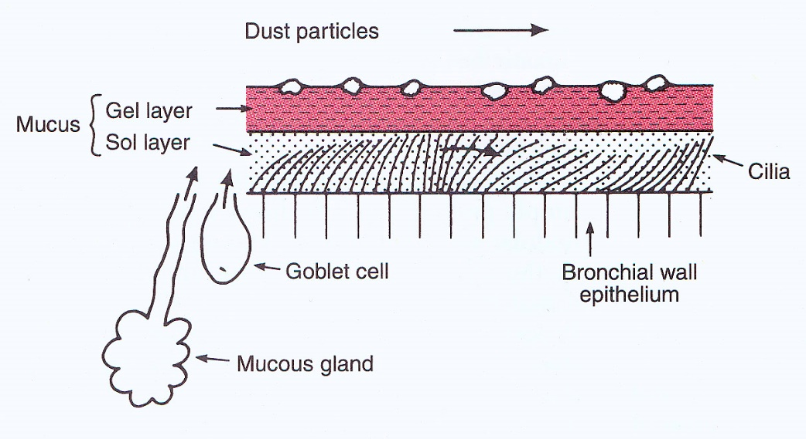
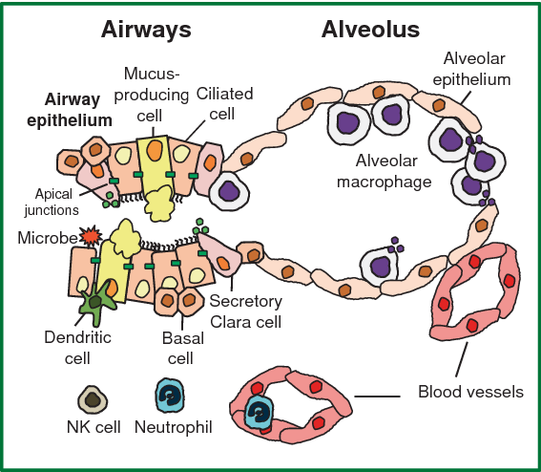
Functions of Conducting Zone
Conducting zone:
Passage of air
Warming
Humidification
Filtration
Immune surveillance
OUT of LUNGS
What is the source of the water vapor?
Role of the mucociliary apparatus in removal of particulates.

Slide 7
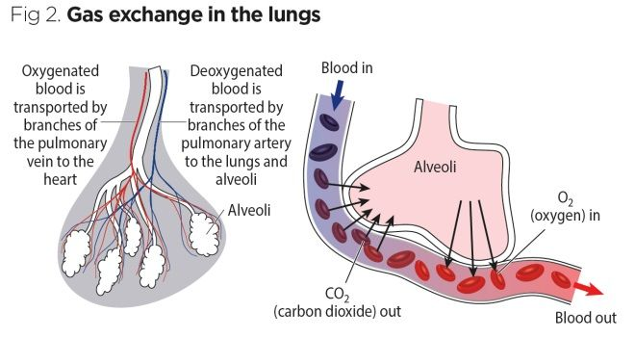
Functions of Respiratory Zone
Respiratory zone:
Passage of air
Gas exchange
Immune surveillance

Slide 8
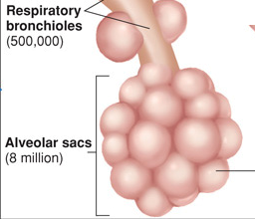
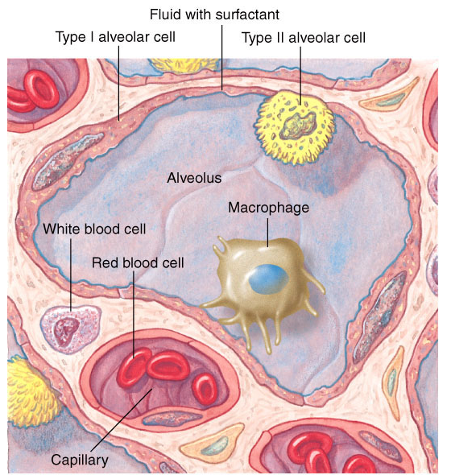
Alveoli Are the Site of Gas Exchange
Alveoli
Total # = ~300 x 10⁶
0.25 - 0.5 mm in diameter
Total area = 60 - 80 m²
Alveolar wall
Type I alveolar cells – the major lining cells, accounts for 95-97% of total surface area
Type II alveolar cells – production of surfactants
Air-blood barrier = ~0.3 μm

Slide 9
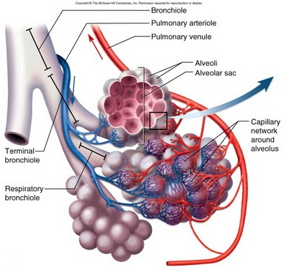
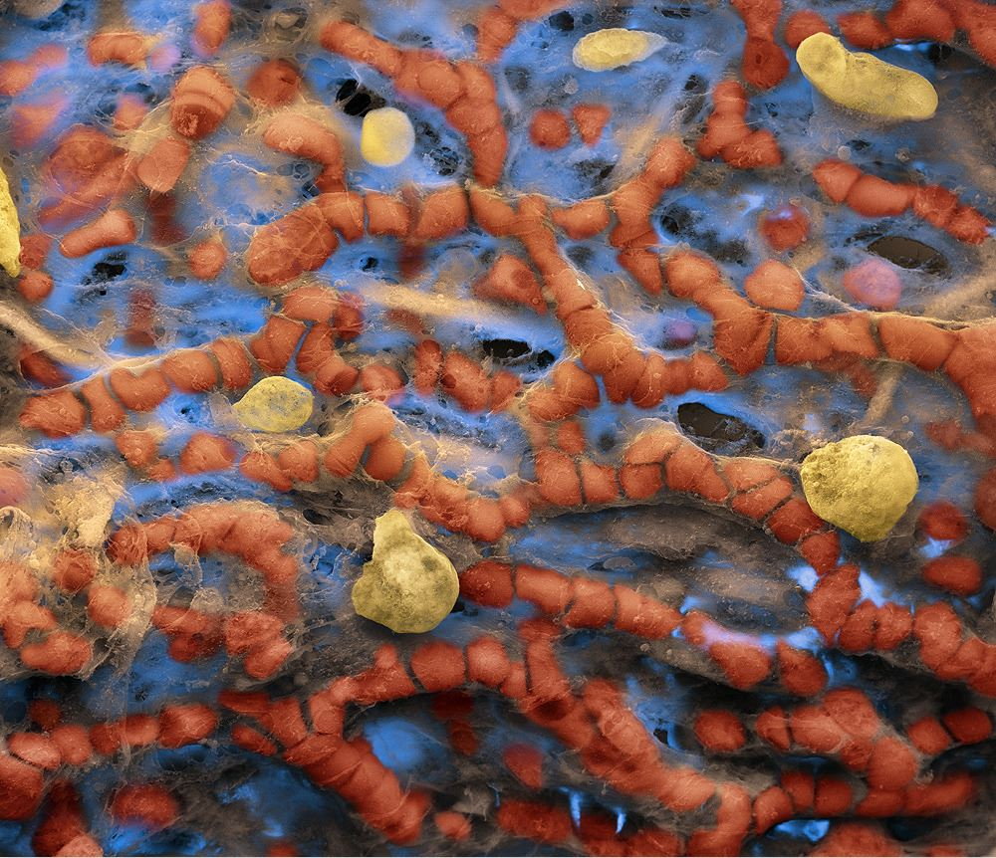
Capillary Net Over Alveolar Sacs
Scanning electron micrograph of capillary net over alveoli.

Slide 10
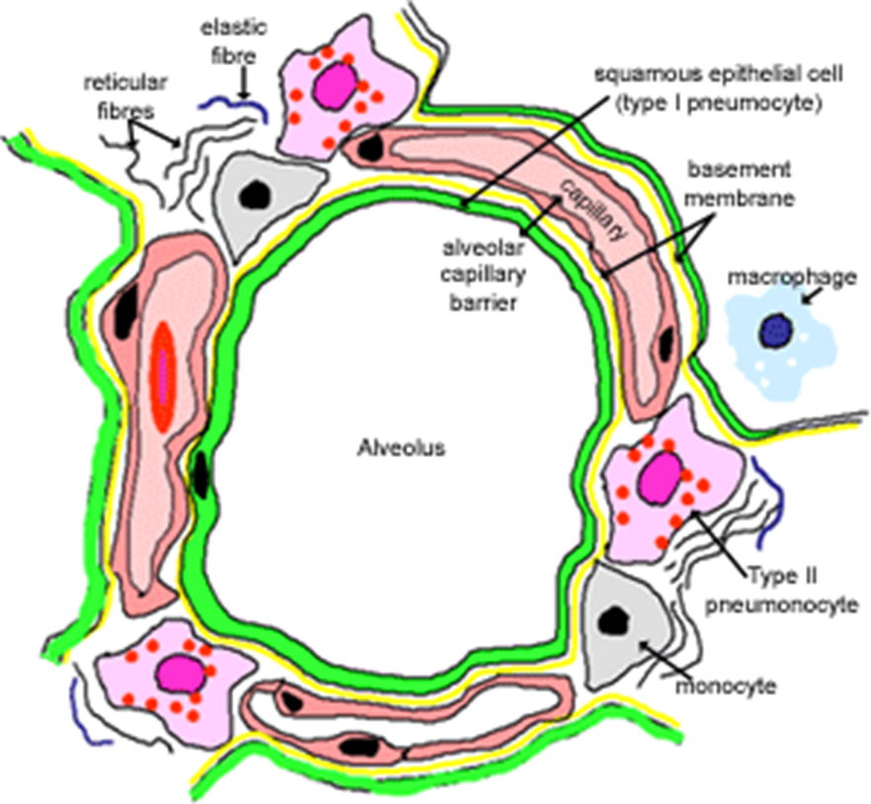
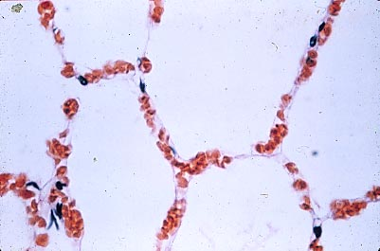
Very Thin Diffusion Barrier for Gas Exchange
Layers of respiratory membrane:
1. Fluid layer with surfactant.
2. Type I alveolar cell membranes.
(3. Narrow interstitial space.)
4. Capillary endothelial cell membranes.
O₂
CO₂

Slide 11
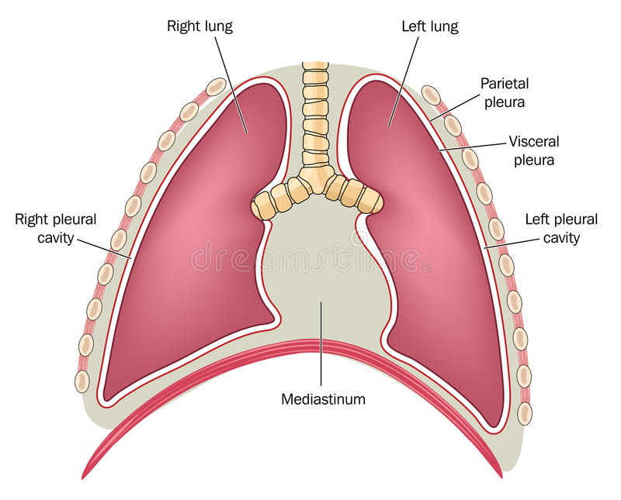
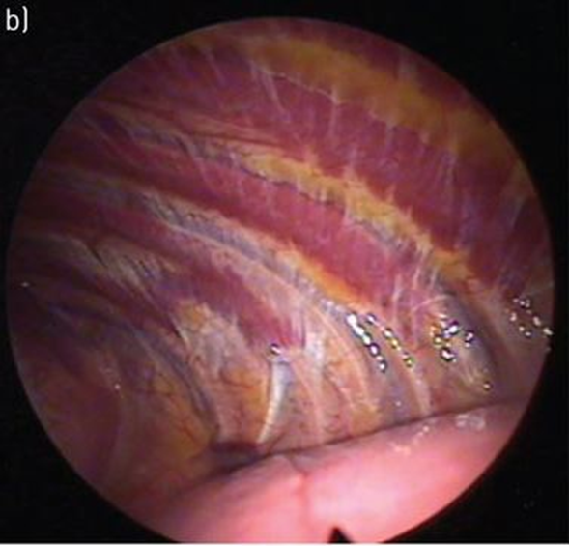
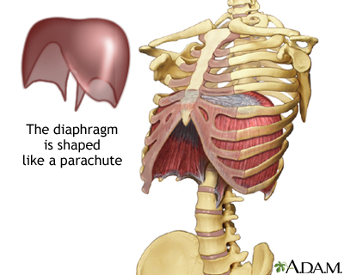

Thoracic Cavity
Thoracic cavity surrounded by rib cage (chest wall) and the respiratory muscles.
Pleural (intra-pleural) space
Thin fluid layer between visceral pleura covering lungs (visceral) and parietal pleura lining thoracic cavity walls.
*Air-free, potential space -> lungs cling to inside of thorax.
Diaphragm – muscle between thoracic & abdominal cavities.
Healthy pleural space (air introduced).

Slide 12
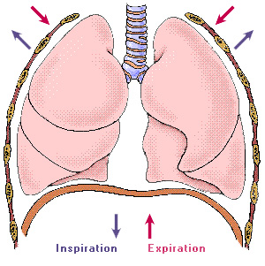
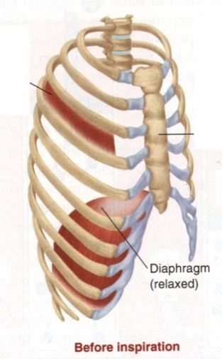
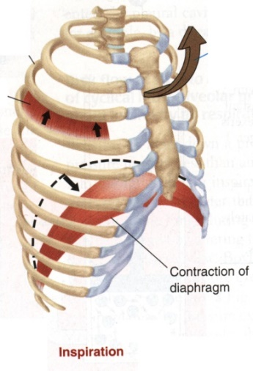
Respiratory Muscles and Inspiration
Quiet Inspiration - active process:
1. Contraction of diaphragm → ↑ thoracic vol vertically
2. Parasternal and external intercostals contract → raising the ribs → ↑ thoracic vol laterally (horizontally)
Sternum
Before Inspiration
Inspiration

Slide 13
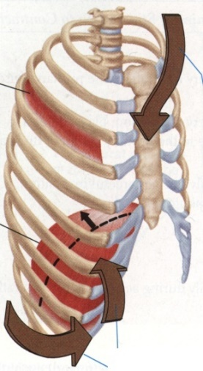
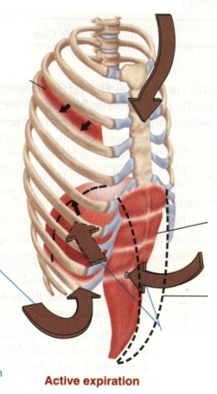
Respiratory Muscles and Expiration
Quiet expiration – passive process, relaxation of inspiratory muscles.
Forced expiration – active process assisted by the abdominal muscles.
Before Inspiration
Inspiration
Quiet Expiration
Forced Expiration

Slide 14
Chapter 16 Respiratory Physiology
Part 2 – Physical aspects and mechanics of ventilation

Slide 15
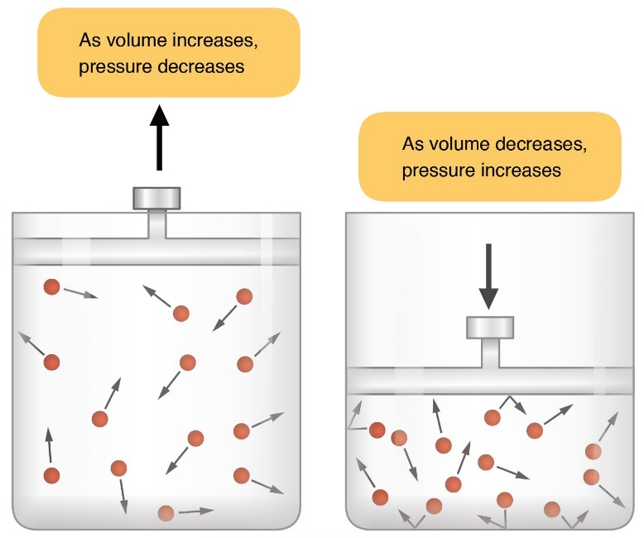
Physics of Gas Pressures 1
Boyle’s Law
*Boyle’s Law
At a constant temperature P₁V₁ = P₂V₂
Thoracic expansion and contraction -> air movement

Slide 16
Pressure Gradients
How do we get O₂ into the body and CO₂ out of the body?
Ventilation = air in and out of lungs
Results from pressure differences (gradient) induced by changes in lung volumes
Pressure (P) gradient – results in net gas flow & diffusion from high P to low P
Similar principles apply to respiration
For P_{O2} – alveolar space > blood plasma > interstitial fluid > cytosol > mitochondria
For P_{CO2} – mitochondria > cytosol > interstitial fluid > blood plasma > alveoli

Slide 17
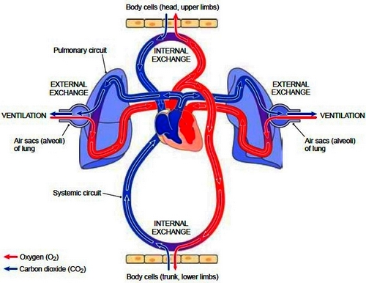
Pressure Gradients
CELLULAR RESPIRATION
CELLULAR RESPIRATION
Anatomically correct version of the last slide.

Slide 18
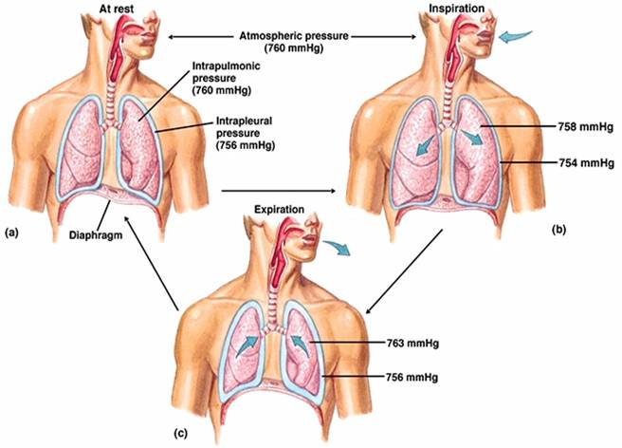
3 Pressures to Follow
Atmospheric – always 760 mm Hg
Alveolar (Intrapulmonary) – at rest, during inspiration, during expiration
Pleural (Intrapleural) – at rest, during inspiration, during expiration

Slide 19
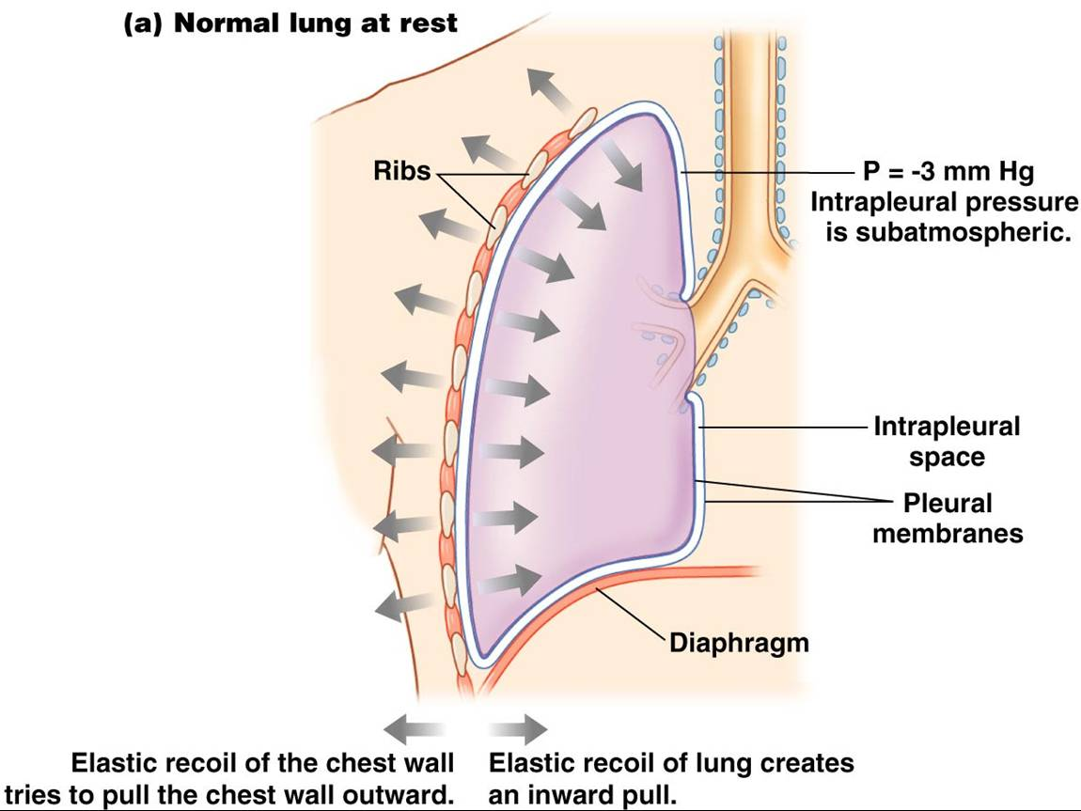
Natural Properties of Lungs & Chest Wall
The lung can be viewed as a passive, elastic container.
The “pleural space” contains only a film of fluid, so lungs normally remain in contact with the chest walls.
The lung tends to recoil inward and the chest wall outward
*These recoil forces in opposite directions create a negative (sub-atmospheric) pleural pressure: -3 to -4 mm Hg relative to atmospheric and alveolar pressures.
-> Lungs expand and contract along with the thoracic cavity.
What happens if the pleural space is disrupted by air or fluid?

Slide 20
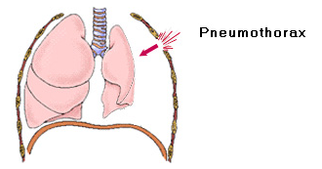
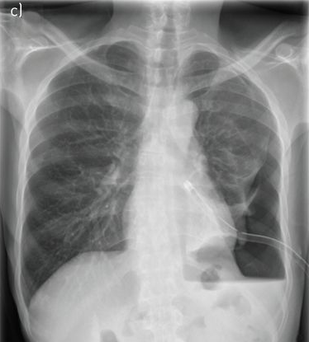
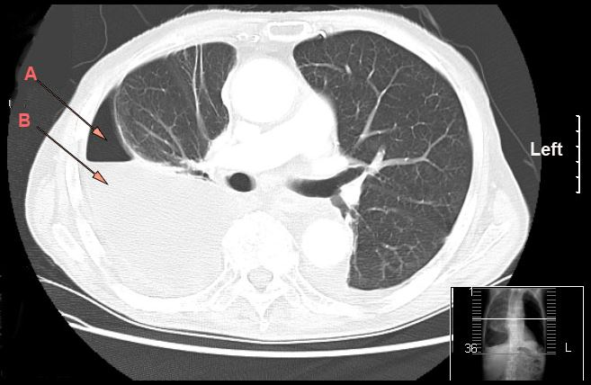
Importance of the Pleural Space
Mediastinum separates each side of thorax.
Air (pneumothorax) or fluid (hydrothorax, generically) -> relative negative pressure lost -> lung lobes collapse.
New pressure gradient -> pneumothorax.
R
L
CT scan of right-sided hydropneumothorax. A = air, B = fluid.
Left-sided pneumothorax with a chest tube in place.

Slide 21
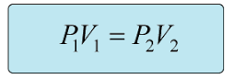
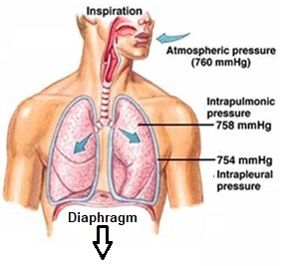
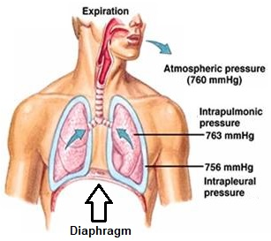
Mechanics of Breathing (Ventilation)
Ventilation occurs as a result of pressure gradients induced by changes in lung volume.
During inspiration:
Contraction of inspiratory muscles → ↑ chest vol → ↑ pleural vol → ↓ pleural P → ↑ lung vol → ↓ alveolar P
→ atmospheric P > alveolar P → generation of pressure gradient → air to flows into the lung
Energy -> muscular contraction -> works against the elastic recoil forces of the lung.
During (passive) expiration:
↓ lung vol → ↑ alveolar pressure above atmosphere (alveolar P > atmospheric P) → air goes out
Elastic recoil forces of the lung contribute to change in pressure gradient.

Slide 22
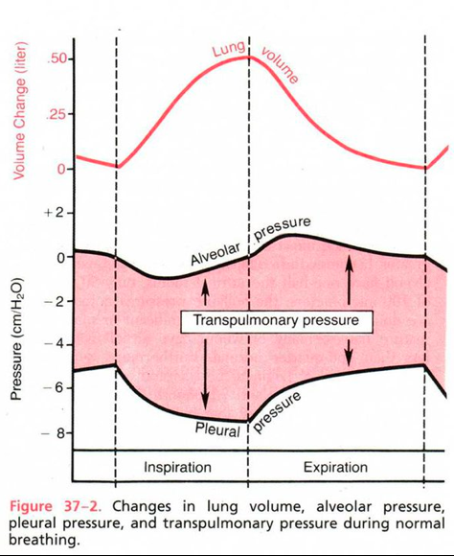
Alveolar & Pleural P
Relative pressures
Pleural P – ALWAYS lower than alveolar P & atmospheric P
ALWAYS negative (sub-atmospheric)
Alveolar P – may be “-” (inspiration) or “+” (expiration)
Trans-pulmonary P = Δ P across the wall of the lung
= Alveolar P – Pleural P
Always positive
Increasing difference vs. decreasing difference.
Atmospheric
Pressure
 | Inspiration | Expiration
Alveolar P | -1 to -3 | +1 to +3
Pleural P | -7 to -6 | -5 to -3
*Pressures relative to atmospheric pressure.

Slide 23
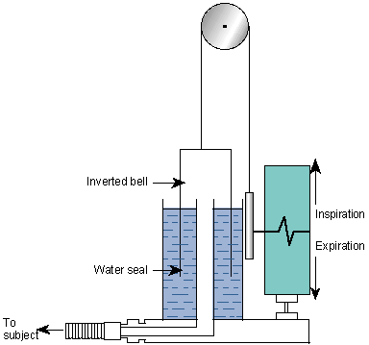
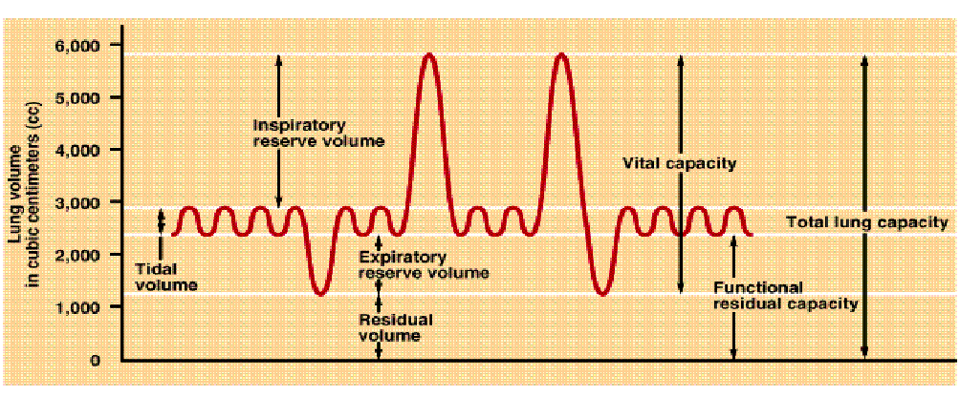
Pulmonary Volumes, Capacities, & Function Tests
Lung volumes - tidal vol (TV), inspiratory reserve vol (IRV), expiratory reserve vol (ERV), and residual vol (RV).
Lung capacities – inspiratory capacity (IC), functional residual capacity (FRC), vital capacity (VC), and total lung capacity (TLC).
Capacity – sum of more than 1 volume
Timed vital capacity (or forced expiration volume for the 1st second, FEV₁) – normal is > 80%
Spirometry

Slide 24
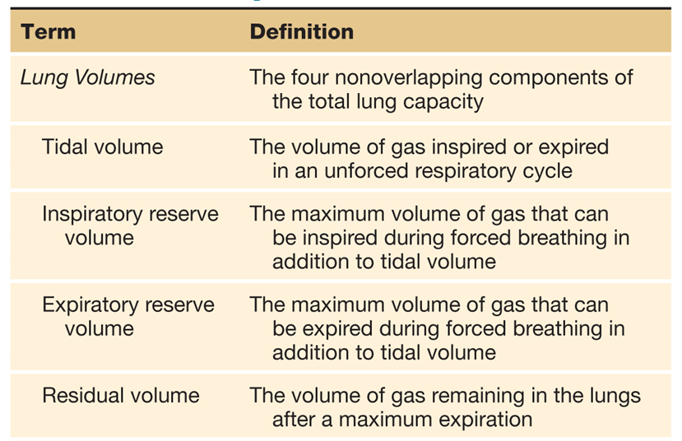
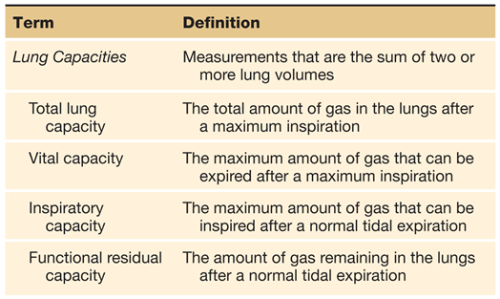
Pulmonary Volumes & Capacities
*
*
*
*

Slide 25
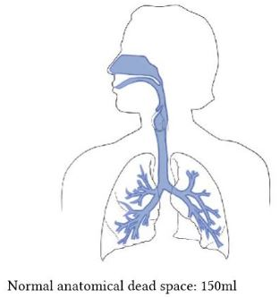
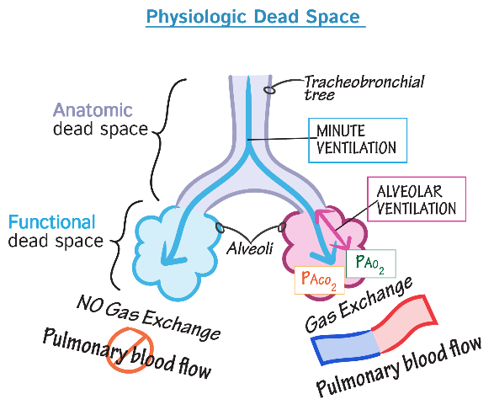
Dead Space
Dead space = regions of the airways that are ventilated but no gas exchange occurs.
Physiologic dead space = anatomic dead space + alveolar dead space
Anatomic dead space
*Air in the conducting airways of respiratory system that does NOT participate in the gas exchange.
Not all of the inspired air reaches the alveoli.
Inhaled fresh air mixed with expired air in anatomical dead space.
Alveolar or functional dead space
*Air in the respiratory zone that is ventilated but does NOT participate in gas exchange.
Due to lack of blood flow to those alveoli.

Slide 26
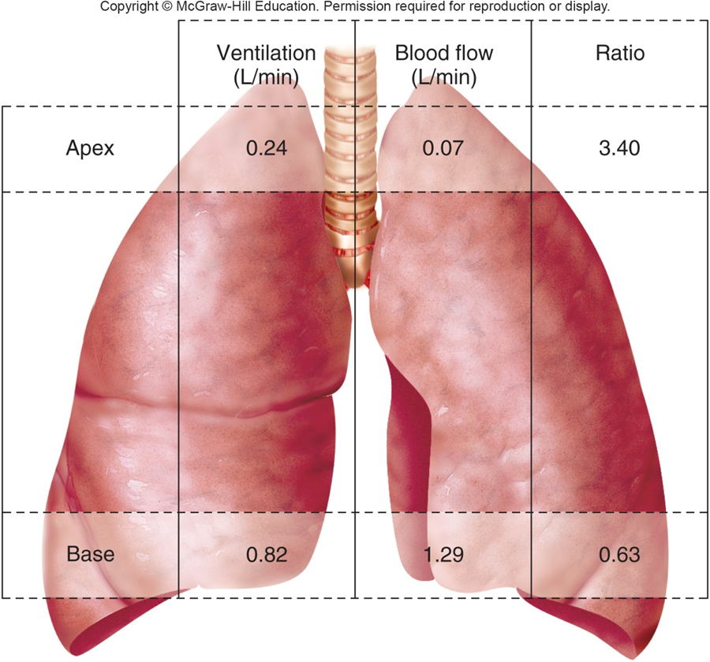
Ventilation-Perfusion Ratio (V/Q)
V_{A} = alveolar ventilation
Q = blood flow
For efficient gas exchange (O₂ in, CO₂ out), want level of ventilation to match blood flow in alveoli. V/Q ≈ 0.8
V_{A} is greater in the apices of the lungs -> high V/Q – overventilated and underperfused
Q is greater in the basal lung lobes -> low V/Q – underventilated and overperfused

Slide 27
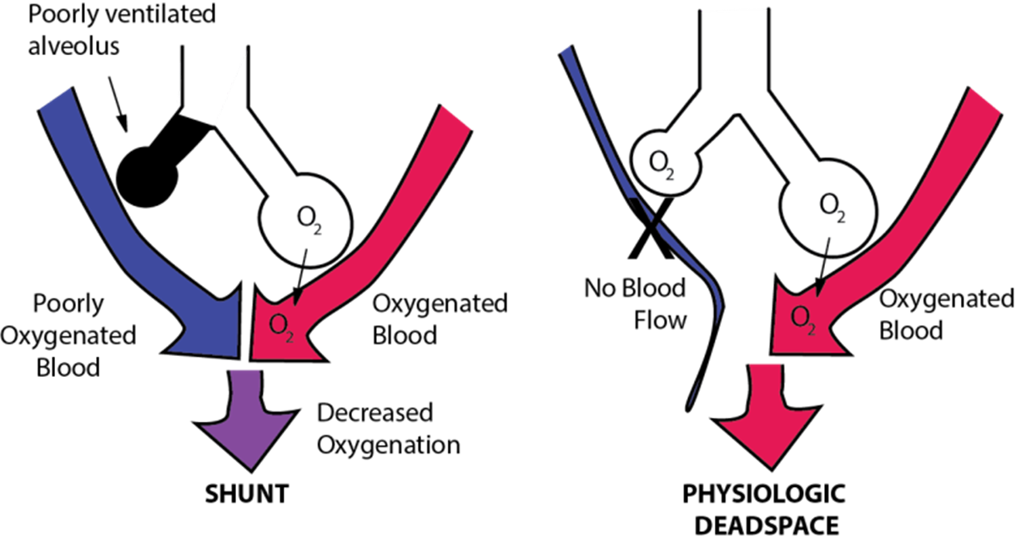
Ventilation-Perfusion Ratio (V/Q)
Pulmonary arterioles try to maximize V/Q ratio ≈ 0.8
Systemic arterioles (e.g., muscle beds) dilate if arterial O₂ levels (P_{a}O₂) are low -> more blood with O₂ delivered.
Pulmonary arterioles constrict if alveolar O₂ levels (P_{A}O₂) are low. Dilate if P_{A}O₂ high.
What does this accomplish if P_{A}O₂ is low in individual alveoli or a region of lung?
If P_{A}O₂ is high in alveoli or a region of lung?
V/Q mismatch occurs with different disease states.

Slide 28
Chapter 16 Respiratory Physiology
Part 3 – Factors affecting ventilation

Slide 29
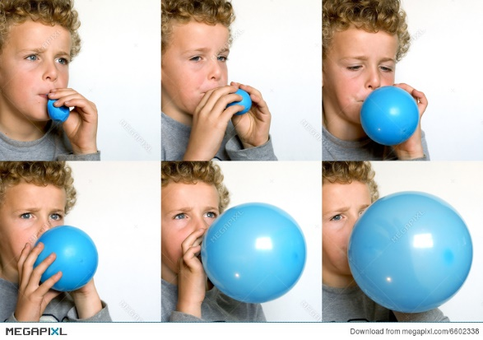
Factors Affecting Ventilation
1. Compliance – distensibility (stretchability)
Change in lung vol per change in transpulmonary P
Compliance = ΔV/ΔP
100 x more distensible than a balloon
Compliance is affected by elastance (2) ; and surface tension (3)
2. Elastance (elasticity) – recoil ability, resistance to distension
Elasticity = 1/compliance
Tendency to return to initial size after distension.
High content of elastin proteins
Elastic tension ↑ during inspiration and ↓ during expiration
Balloon analogy
Diseases can alter compliance and elasticity (ahead).
https://www.youtube.com/watch?v=v7477AMrUyc
3. Surface tension – to be discussed in the next slides

Slide 30
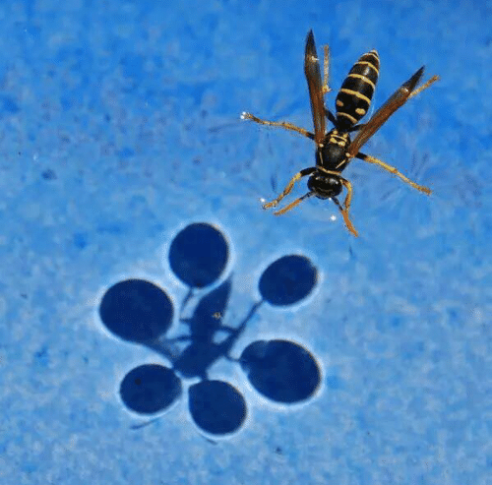
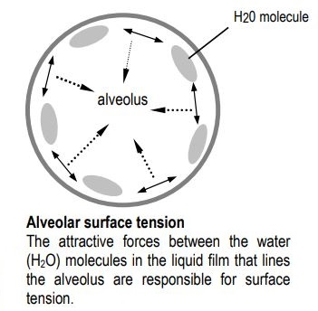

Surface Tension
Thin film of liquid (water) lines alveoli.
Surface tension (T)
Reflects the work needed to ↑ surface area of a liquid at an interface.
Law of Laplace – P in alveoli is directly proportional to surface tension; and inversely proportional to radius of alveoli.
T is the same for same interface.
For the same T, smaller alveoli have higher P to collapse than larger alveoli.
r=2 (P=T) vs. r=1 (P=2T) → collapse of smaller alveoli
↑ P → ↓ compliance → takes more energy to expand.
What helps keep surface tension from collapsing our alveoli?

Slide 31

Surfactants
Surfactants – biochemistry
Produced by type II alveolar cells (pneumocytes).
1. Phospholipids – amphipathic
2. Surfactant proteins – help distribute phospholipids.
Surfactants – functions
Lower surface tension → ↑ compliance.
Prevent collapse of smaller alveoli.
As alveoli radius decreases, surfactant’s ability to lower surface tension increases.

Slide 32



Pulmonary Disorders (1)
Newborn respiratory distress syndrome
Occurs in ~10% of premature neonates.
Underdeveloped anatomy.
Surfactant insufficiency.
Every breath is like the first breath.

Slide 33

Pulmonary Disorders (2)
Restrictive Disorders
Ex., pulmonary fibrosis
Accumulation of fibrous connective tissue in alveolar wall.
↓ vital capacity; normal FEV₁; ↓ compliance
*Reduced lung volume
Evident in which phase of ventilation?

Slide 34


Pulmonary Disorders (3)
Obstructive Disorders
Ex., asthma, cystic fibrosis
Vital capacity may be normal; FEV₁ is < 80%
*Reduced airflow
Evident in which phase of ventilation?

Slide 35



Pulmonary Disorders (4)
Emphysema – alveolar tissue is destroyed, ↑ compliance
Chronic progressive; reduces surface area for gas exchange
Cigarette smoking → ↑ WBC proteinases secretion → ↑ destruction tissue proteins → collapse of alveolar sacs
COPD (chronic obstructive pulmonary disease):
Asthma & emphysema

Slide 36
Chapter 16 Respiratory Physiology
Part 4 – O₂ & CO₂ transport

Slide 37

Physics of Gas Pressures 2
*Dalton’s Law – the law of partial pressures
The pressure exerted by each component in a gaseous mixture is independent of other gases in the mixture, and the total pressure of the mixture of gases is equal to the sum of the separate pressures.
P_{B} = P_{CO2} + P_{O2} + P_{N2} + P_{H2O} = 760 mm Hg atmospheric pressure
Movement of individual gases

Slide 38



Physics of Gas Pressures 3
Henry’s Law
Henry’s Law: C = kP
Concentration of gas in liquid = solubility x partial pressure in liquid.
At equilibrium, partial pressure is equal on both gas and liquid sides, but # of molecules varies depending on solubility of the gas.
Partial pressure of each gas is the same for both.

Slide 39
The Concept of “Dissolved O2”
37º C
plasma
Gases can exist in either in gas phase or in liquid phase (dissolved in blood plasma).
Dissolved gas molecules also exert partial P.
↑ Gas molecules dissolve in blood plasma → ↑ [gas] in blood plasma → ↑ P.
At equilibrium, the # of gas molecules entering (dissolving in) the plasma equals the # of gas molecules leaving the plasma to air phase.
At equilibrium does not mean that the # of gas molecules (concentration) in the air and the liquid are equal.
air

Slide 40


Respiration and Pressure Gradient
O₂
ventilation
How do we get O₂ into the body and CO₂ out of the body? (Ventilation)
A) In and out of the lungs:
Gas exchange results from pressure differences (gradient) induced by changes in lung volumes.
B) From the lungs to the cells in the body (O₂) and from the cells in the body to the lungs (CO₂):
*For P_{O2} – alveolar space P_{AO2} > blood plasma P_{aO2} > interstitial fluid > cytosol > mitochondria
*For P_{CO2} – mitochondria > cytosol > interstitial fluid > blood plasma P_{vCO2} > alveoli P_{ACO2}
Higher P_{O2} Lower P_{CO2}
P_{A}
gas exchange
diffusion
capillaries
P_{v}
P_{a}
perfusion
P_{v}
P_{a}
capillaries
gas exchange
diffusion
diffusion
P_{A} = partial pressure alveolar
P_{a} = partial pressure arterial
P_{v} = partial pressure venous
Higher P_{CO2} Lower P_{O2}
CO₂ in opposite direction

Slide 41



Pulmonary Circulation vs. Systemic Circulation
Rate of blood flow through the pulmonary circulation = flow rate through the systemic circulation.
Pulmonary vascular resistance is lower -> lower BP.
Structure of pulmonary arteries – contains less smooth muscle
What purposes might this serve?
Vena cavae
RA -> RV
LA -> LV
Look at all those systemic vessels vs. much less pulmonary vessels!
Please know the path of blood through the heart, lungs, and systemic circulation.

Slide 42



Partial Pressures of Gases
Generation of pressure gradients for net gas exchange.
What is the P gradient for O₂ in the lungs (P_{vO2} vs. P_{aO2})?
For CO₂?
Assuming correctly that every O₂ molecule consumed -> one CO₂ molecule (roughly)…why the big difference between O₂ and CO₂?
64
5

Slide 43

CO₂ Diffuses Much More Readily in Plasma Than O₂
Solubility coefficient CO₂/solubility coefficient O₂ = 0.57/0.024 = 23.75/1.
CO₂ has a much higher diffusion rate in fluid/tissue phase vs. O₂.
Need a much higher diffusion gradient for O₂ to supply enough molecules to tissues to produce ATP.
Much lower diffusion gradient for CO₂ needed to bring enough molecules to lung for exhalation.

Slide 44


Forms of O₂ Transport
O₂ is transported in blood in:
1. Dissolved O₂ (< 2%)
2. Hb-O₂ (> 98%)
Hemoglobin – 280 million Hb/Red Blood Cell
Each Hb has 4 polypeptide chains and 4 hemes
*1 heme binds to 1 O₂, thus 1 Hb binds to 4 O₂ maximally
Oxyhemoglobin (Hb-O₂) – O₂ binds to Fe²⁺ of heme
Deoxyhemoglobin – Hb only, no O₂, also contain Fe²⁺ (oxygenation, not oxidation)

Slide 45



Hemoglobin
Oxygen-carrying capacity of blood determined by its [Hb].
Anemia - ↓ RBCs -> [Hb] below normal.
Polycythemia - ↑ RBCs -> [Hb] above normal.
Hb production controlled by erythropoietin.
Production stimulated by P_{CO2} delivery to kidneys.
Loading/unloading depends on P gradient .

Slide 46


Problems Related to Hemoglobin
Methemoglobin – Fe²⁺ oxidized -> Fe³⁺, cannot bind with O₂.
Brown blood, brownish-blue mucous membranes.
Carboxyhemoglobin (CO-Hb) – carbon monoxide.
The bond with CO is 210x stronger than the bond with O₂.
Transport of O₂ to tissues is impaired.

Slide 47

Hb-O₂ Dissociation Curve
X-axis denotes P_{O2} (mm Hg)
Y-axis denotes O₂ saturation rate (%) or O₂ content (mL O₂ /dL blood)
The higher the P_{O2}, the higher Hb-O₂ saturation

Slide 48

Hb-O₂ Saturation
Gas exchange at alveolar space → loading of O₂ → oxygenated blood → P_{O2} = 100 mm Hg → O₂-Hb is ~98%.
At peripheral tissues → unloading of O₂ → deoxygenated blood → P_{O2} = to 40 mm Hg → O₂-Hb is ~ 75%.
The physiological range of represents the flatter portion of the sigmoid Hb-O₂ curve
Only ~20-25% of O₂ from Hb-O₂ is unloaded
How about the steep portion of the curve?
What happens to unloading of O₂ when PO2 ↓ ↓?

Slide 49

Hb-O₂ Saturation: Affinity of Hb for O₂ Changes
Structure of Hb changes conformation as subsequent O₂’s bind or depart.
Affinity of Hb for O₂ increases as more O₂ binds -> Hb holds O₂ more tightly at higher PO₂’s (pulmonary capillary beds).
Affinity of Hb for O₂ decreases as more O₂ departs -> Hb holds O₂ less tightly at lower PO₂’s (tissue capillary beds).

Slide 50

Hb-O₂ Saturation: A More Helpful Figure
This figure incorporates the role of affinity of Hb for O₂ based on P_{O2}.

Slide 51

Factors Affecting Hb-O₂ Curve
Shifts in the curve reflect the effect of a physiological factor on affinity of Hb for O₂.
A shift of curve to left increases affinity of Hb for O₂. What does this mean in the lungs? In the tissues?
A shift of curve to the right decreases affinity of Hb for O₂. What does this mean in the lungs? In the tissues?
↑ O₂
affinity
↓ O₂ affinity

Slide 52

Factors Affecting Hb-O₂ Curve
For each factor, ask yourself whether the change will result in a greater need for O₂ in the tissues. “Yes” -> right shift.
Factors affecting O₂-Hb affinity
↓ pH (acidosis) → right shift
↑ P_{CO2} (suggests hypoxemia) → right shift (Bohr effect)
↑ temperature → right shift
↑ [2,3-DPG] in RBC → right shift
What about left shifts?

Slide 53

2,3-DPG Alters Affinity of Hb for O₂
2,3-diphosphoglycerate or 2,3 bisphosphoglycerate (2,3-BPG)
Metabolic by-product of glycolysis in RBCs.
O₂ inhibits its production.
2,3-DPG binds Hb -> decrease in affinity for O₂ -> right shift where more O₂ is released in tissues.
2,3-DPG production ↑ with hypoxemic conditions
Anemia
High altitudes
Some forms of chronic lung disease

Slide 54

Muscle Myoglobin
Red pigment found exclusively in striated muscle (skeletal and cardiac muscle fibers).
*Has a higher affinity for O₂ than Hb.
Ferrying effect – acts as a “go-between” in the transfer of O₂ from blood to the mitochondria within muscle cells.
O₂ storage function – in cardiac muscles.

Slide 55
Chapter 16 Respiratory Physiology
Part 5 – Acid-base balance

Slide 56

Acid-Base Balance Part I
Normal blood pH is 7.40 (7.35 – 7.45)
Acidosis – pH < 7.35 ↑ H⁺ ions
Alkalosis – pH > 7.45 ↓ H⁺ ions
2 major classes of acids in body:
A volatile acid can be converted to a gas
CO₂ in bicarbonate buffer system can be breathed out (lungs).
All other acids are non-volatile and cannot leave blood
Non-volatile acids – lactic acid, fatty acids, ketone bodies.
Need to bind to buffer molecules.
Buffers in the body include HCO₃–, PO₄^{2–}, proteins including Hb.
Kidneys – excrete H⁺ into urine, reabsorb HCO₃⁻ from urine (Part II).

Slide 57

Bicarbonate Buffer System
CA
CA
CO₂ + H₂O ⇌ H₂CO₃ ⇌ H⁺ + HCO₃⁻
Carbon dioxide ⇌ carbonic acid ⇌ bicarbonate
CA = carbonic anhydrase enzyme
Catalyzes reaction both directions.
Higher expression in RBCs, gastric mucosa, pancreatic exocrine cells, renal tubules.
Why would it be in all these tissues?
Henderson-Hasselbalch equation
pH = 6.1 + log ( [HCO₃⁻] / [CO₂] )
[CO₂] is adjusted by lungs, [HCO₃⁻] by kidneys
Free H⁺ in nmol/L concentrations, free HCO₃⁻ in mmol/L concentrations.
CA
CA
CA
CA

Slide 58
Acid-Base Balance
CA
CA
CO₂ + H₂O ⇌ H₂CO₃ ⇌ H⁺ + HCO₃⁻
What effect does adding HCO₃⁻ have on plasma [H⁺]?
What does increased [HCO₃⁻] do to pH? Decreased?
What effect does adding CO₂ have on plasma [H⁺]?
What does increased [CO₂] do to pH? Decreased?

Slide 59

Respiratory Acid-Base Balance
*Ventilation usually adjusted to metabolic rate to maintain normal CO₂ levels.
What does increased respiratory rate or ventilation do to plasma [CO₂]?
What does decreased respiratory rate or ventilation do to plasma [CO₂]?
So how would the lungs (controlled by the brain) respond to ↑ plasma [CO₂], ↑ plasma [H⁺], and ↓ plasma pH?
And how would the lungs (controlled by the brain) respond to ↓ plasma [CO₂], ↓ plasma [H⁺], and ↑ plasma pH?

Slide 60
Respiratory Acid-Base Balance
Respiratory acidosis
Caused by hypoventilation – CNS depression, neuromuscular disorders, chest wall restriction, pulmonary tissue disease, airway obstruction.
Accumulation of CO₂ in the tissues → ↑ P_{CO2} in blood → ↓ pH in blood
Respiratory alkalosis
Caused by hyperventilation – CNS disease, acute asthma, hypoxemia.
Excessive loss of CO₂ → ↓ P_{CO2} → ↑ pH in blood
Where is the H⁺ when CO₂ is exhaled?

Slide 61


Now You Are Ready for CO₂ Transport
CO₂ transported in the blood in 3 forms:
Dissolved CO₂ (10%) – accounts for P_{CO2}
HCO₃⁻ (70%)
Carbaminohemoglobin (20%)
Unloading of O₂ → Hb-CO₂ formed
CO₂ does NOT bind heme in Hb.
3 things to remember to understand this:
Carbonic anhydrase is located in RBCs.
CO₂ readily crosses plasma membranes.
Bicarb (HCO₃⁻) needs to be transported across plasma membranes. Antiporter exchanges chloride (Cl⁻) for bicarb.

Slide 62

Now You Are Ready for CO₂ Transport
At systemic capillaries
Chloride shift into RBCs
At pulmonary capillaries
Reverse chloride shift out of RBCs

Slide 63
Chapter 16 Respiratory Physiology
Part 6 – Regulation of breathing

Slide 64


Regulation of Breathing
For metabolic homeostasis, the frequency and amplitude of breathing must respond to metabolic changes.
Sensors: Chemoreceptors for chemical changes, mechanoreceptors for mechanical changes.
Integrator: Brain
Continuous display of voluntary and involuntary actions.
Voluntary action is done by cerebrum, hypothalamus, limbic system (anger).
Involuntary action is done by the brain stem respiratory centers (medulla oblongata and pons).
Brain stem respiratory centers
Rhythmicity center (medulla)
Apneustic center (pons)
Pneumotaxic center (pons)
Effectors: Respiratory muscles.

Slide 65

Sensors – Chemoreceptors
2 groups of chemoreceptors that monitor changes in blood P_{CO2}, P_{O2}, and pH.
Central chemoreceptors:
Located in medulla, different from the rhythmicity center.
More sensitive to blood P_{CO2} than blood pH (due to the BBB).
Peripheral chemoreceptors:
Carotid and aortic bodies
Directly detect changes in P_{O2}
Indirectly detect changes in P_{CO2} through pH
H₂O + CO₂ ↔ H₂CO₃ ↔ H⁺ + HCO₃⁻
More sensitive to changes in blood pH than P_{O2}
Peripheral Chemoreceptors

Slide 66

Reminder
Baroreceptors: Carotid sinuses and aortic arch
Chemoreceptors: Carotid bodies and aortic bodies

Slide 67

Pulmonary Mechanoreceptors (1)
Detect mechanical changes of breathing (volume and frequency).
Influence the brain stem respiratory control centers via sensory fibers in vagus nerves.
Pulmonary stretch receptors (PSR) – detect volume changes; present in the smooth muscle of the airways; slowly adapting; activated during inspiration to force expiration.
Hering-Breuer inflation reflex:
Triggered to prevent over-inflation of the lungs.

Slide 68

Pulmonary Mechanoreceptors (2)
Pulmonary irritant receptors (PIR)
A.k.a. – rapidly adaptive receptors on Aδ fibers
Detect frequency of breathing
Respond to smoke, smog, and particulates -> cause coughing
Unmyelinated C fibers
Sensory neurons located in lungs
Stimulated by noxious substances such as capsaicin
Produces initial apnea -> rapid, shallow breathing

Slide 69
The Rhythmicity Center
Located in medulla oblongata
generate automatic basic rhythm of breathing
Basic rhythm is irregular, erratic, and unstable. It is NOT the normal rhythm
Consists of interacting neurons that fire either during inspiration (I neurons) or expiration (E neurons)
Quiet expiration is a passive process that occurs when the I neurons are inhibited
Dorsal respiratory group (DRG) – inspiration
Ventral respiratory group (VRG) - expiration

Slide 70


The Pontine Centers
Basic rhythm generated by the medullary rhythmicity center must be adjusted by pons.
Apneustic center:
Promotes long inspiration and sharp expiration (apneustic breathing).
Pneumotaxic center:
Needs to work together with apneustic center.
Antagonizes the apneustic center’s effects.
Inhibits inspiration, thus the normal rhythm.

Slide 71

Overview

Slide 72
Questions?

